Slide 1

ETM 534/634 - Technology Roadmapping
Summer 2022
Cyber Security Roadmap for System Lockout
In the Energy sector
Professor: Tugrul Daim
Presented by Team3:
Elsamol, Amrutha, Haydar, Ned, Vaishali, Farzanah

Slide 2
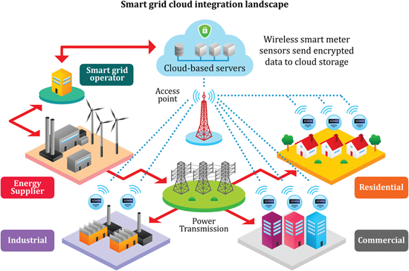
Introduction
To improve the efficiency and reliability, a significant investment has been made by industry and government to build a smarter and more automated/connected power grid system.
Since power grids span a wide geographic area, public and private networks can provide a communication path between remote sites and a control center. These capabilities also open doors for criminals, terrorists, “hacktivists,” and foreign governments to access a power grid and cause disruptions to the normal operation of the grid. This causes lengthy blackouts which can impact national security, public safety, and the national economy. in a catastrophic manner.

Slide 3

Background
Many industry and government reports have identified that cyber intruders have become a serious threat to the secure operation of a smart grid. Forty-six cyber attack incidents have been reported in the energy sector in 2015 alone, most of which targeted the IT system of utilities and vendors. The U.S. Department of Energy (DOE) indicates that the actual number of cyber attacks is higher than reported . To identify and eliminate cyber vulnerabilities in a smart grid, methods to detect cyber intrusions and mitigate their impact need to be developed.
On December 23, 2015, the power grid of Ukraine was hacked, which resulted in power outages for roughly 230,000 consumers in Ukraine for 1-6 hours. The attack took place during the ongoing Russo-Ukrainian War (2014-present) and is attributed to a Russian advanced persistent threat group known as "Sandworm".

Slide 4
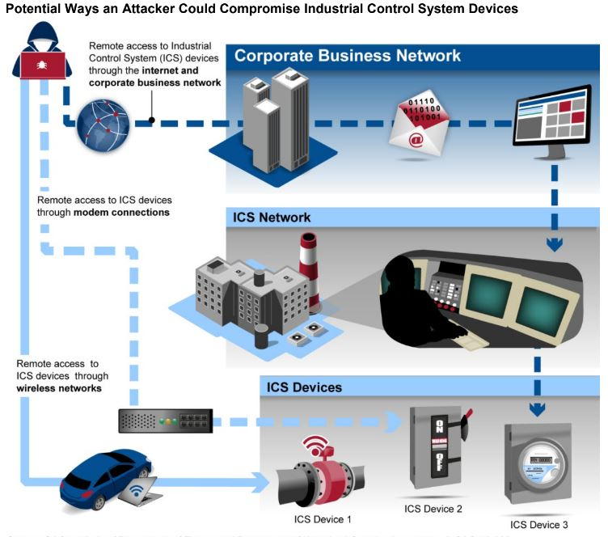
Notes:
What GAO Found
The electric grid faces significant cybersecurity risks:
• Threat actors. Nations, criminal groups, terrorists, and others are increasingly capable of attacking the grid.
• Vulnerabilities. The grid is becoming more vulnerable to cyberattacks—particularly those involving industrial control systems that support grid operations. (The figure below is a high-level depiction of ways in which an attacker could compromise industrial control systems.) The increasing adoption of high-wattage consumer Internet of Things devices—“smart” devices connected to the internet—and the use of the global positioning system to synchronize grid operations are also vulnerabilities.
• Impacts. Although cybersecurity incidents reportedly have not resulted in power outages domestically, cyberattacks on industrial control systems have disrupted foreign electric grid operations. In addition, while recent federal assessments indicate that cyberattacks could cause widespread power outages in the United States, the scale of power outages that may result from a cyberattack is uncertain due to limitations in those assessments

Slide 5

Drivers
Without physical security of the building and network, hackers or even an employee can exploit it.
One of the most important problems of Cyber security is the lack of a fast and easy authentication method.
In the generation of a technology roadmap, it may be necessary to consider redundant communication techniques, especially where critical control mechanisms are concerned. If the system relies on a single point of failure, it is easier to disable the system.
Economic effects
Notes:
Computer controls depend upon some kind of digital connection to a control mechanism. A physical attack on a sub-station can disable that control connection, as was done at the Metcalf substation in San Jose, California, where the telephone cables providing the control signals were physically cut prior to a kinetic attack. So, the assumption of continuous cyber connection is not necessarily valid. A nefarious actor with access to a switch box would need do no more than disconnect ethernet cables to cause havoc in the command-and-control network.

Slide 6

Objectives
Work with a company in the energy sector to identify the complexity and challenges in power grid that can be solved by incorporating system lockout methodology.
Researching a possible road map to implement the feasible lockout system technology.
Notes:
https://www.energy.gov/sites/prod/files/oeprod/DocumentsandMedia/roadmap.pdf

Slide 7

Methodology
Analysis
Reviewing government assessment reports and policies
Literature review
Notes:
SWOT analysis

Slide 8
References
https://www.osha.gov/etools/electric-power/hazardous-energy-control/lockout-tagout-generation
https://www.osha.gov/etools/lockout-tagout
https://safetyculture.com/topics/lockout-tagout/
https://www.ijaar.org/articles/v8n5/sms/ijaar-v8n5-May22-p8505.pdf
https://www.en20Systemsergy.gov/sites/prod/files/Energy%20Delivery%%20Cybersecurity%20Roadmap_finalweb.pdf
https://drive.google.com/drive/folders/1JZ-iMoaqjT48FXtyM5cw6xIVHcNrFNe-
https://fuergy.com/blog/7-problems-and-challenges-of-a-power-grid
https://www.energy.gov/sites/prod/files/oeprod/DocumentsandMedia/roadmap.pdf .
https://www.sciencedirect.com/science/article/pii/S0142061517328946
Jay Johnson, 2017, Roadmap for Photovoltaic Cyber Security, Sandia Report, SAND2017-13262, 66 Pages.
https://www.utilitydive.com/news/sophisticated-hackers-could-crash-the-us-power-grid-but-money-not-sabotag/603764/
https://africautc.org/wp-content/uploads/2018/05/E-ISAC_SANS_Ukraine_DUC_5.pdf
https://www.sciencedirect.com/science/article/pii/S1572308922000171?casa_token=at_3-apYhLsAAAAA:5RUZHeA2YlYQuhSP0IewsoLlep9ysN5cHKXHWC3Ll8EqlzOWgZ2AZ77lbMIPGSRbsmE3Ofn_Ag
https://www.aimspress.com/article/doi/10.3934/electreng.2021002?viewType=HTML
https://ieeexplore.ieee.org/abstract/document/4753670?casa_token=0E3nmaom0UQAAAAA:oZ_6T8lbtwq4vK0HutWuqLiCodG-Q4x_VdNCvp2Dm_YyPeEzuNDLWtSsRv0Xk2Oi7hzfhvCq4A

Slide 9
Q&A

